Slide 1
Sketch to Photo Translation
Yuhang Li, Xuejin Chen, Xiangxiang Wang, Sing Bing Kang

Slide 2
Original idea
Sketch to Photo Translation
Problem definition
Why sketch?
Characteristic of Sketch
Related works
Sketch2Photo
Sketch-based classification
Sketch-based retrieval
Image-to-image translation
Exploration
CycleGAN
DiscoGAN

Slide 3
Original idea
Sketch to Photo Translation
Problem definition
Why sketch?
Characteristic of Sketch
Related works
Sketch2Photo
Sketch-based classification
Sketch-based retrieval
Image-to-image translation
Exploration
CycleGAN
DiscoGAN

Slide 4
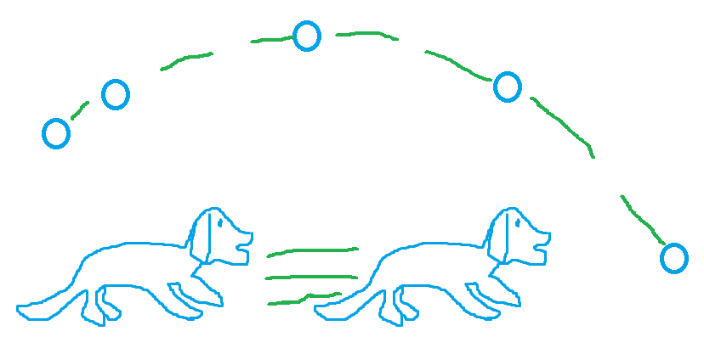
Original idea
Sketch to realistic video
Two kinds of strokes in a sketch:
Object strokes
What object in the scene
Motion strokes
How the object moves in the scene

Slide 5
Original idea
Sketch to realistic video
Two kinds of strokes in a sketch:
Object strokes
What object in the scene
Motion strokes
How the object moves in the scene
It is difficult to obtain corresponding videos that match both object strokes and motion strokes for training!

Slide 6
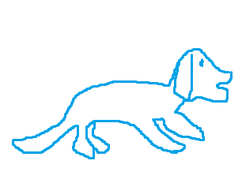
Original idea
Sketch to realistic video
Two kinds of strokes in a sketch:
Object strokes
What object in the scene
Motion strokes
How the object moves in the scene
It is difficult to obtain corresponding videos that match both object strokes and motion strokes for training!
Focus on object strokes!

Slide 7
Original idea
Sketch to Photo Translation
Problem definition
Why sketch?
Characteristic of Sketch
Related works
Sketch2Photo
Sketch-based classification
Sketch-based retrieval
Image-to-image translation
Exploration
CycleGAN
DiscoGAN

Slide 8
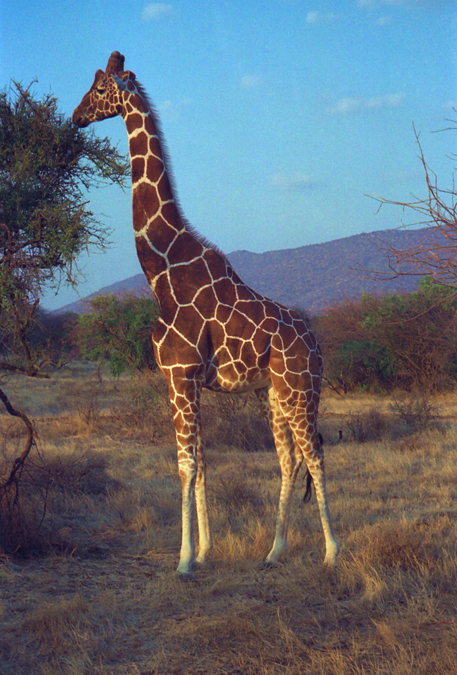
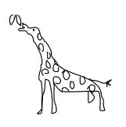
Problem definition
Sketch-based image generation
Given a sketch of one object, we want to generate a new but realistic image that preserves (Discuss)
Object class: giraffe, elephant, chair or car
View point
Layout: size of the object, position in the image
Pose: standing or sitting
Background ?
Shared information!
？

Slide 9
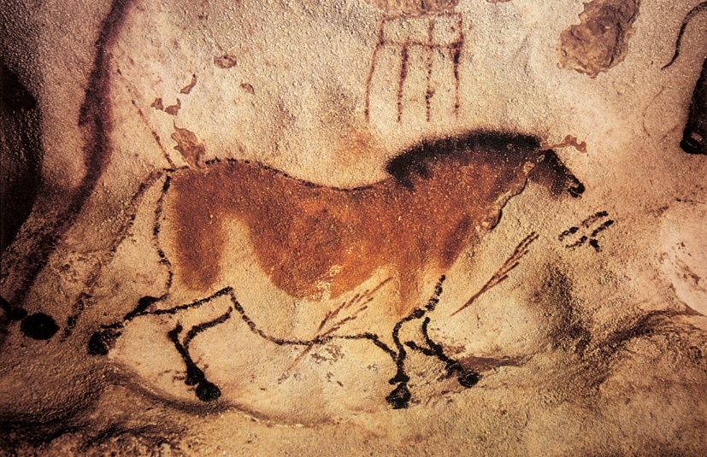
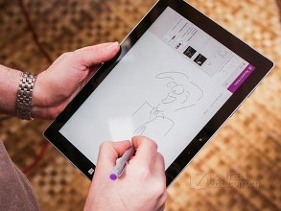
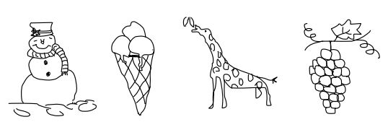
Sketch: why sketch?
A universal form of communication across nations and cultures
Tracing back to prehistoric cave painting
Conveying abstract concepts visually
A sketch can speak a thousand words
Becoming more important due to the popularity of touch devices

Slide 10
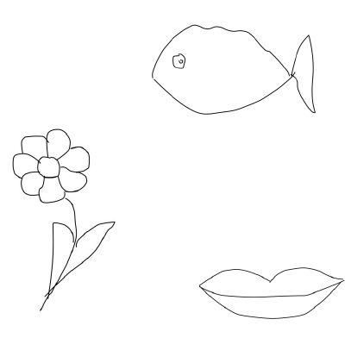
Characteristic of Sketch
Iconic
Sketches can be highly abstract.

Slide 11
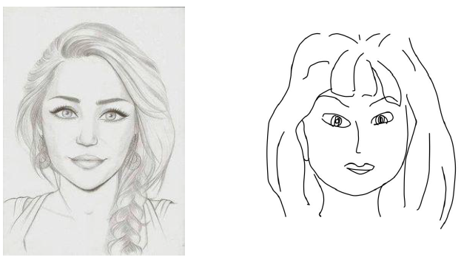
Characteristic of Sketch
High intra-class variation
Sketches drawn by different people vary in the level of abstraction or deformation.

Slide 12
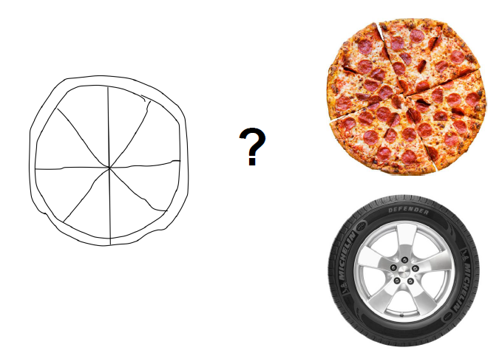
Characteristic of Sketch
Lack of visual cues
Sketches are lack of colors and textures compared to photos.

Slide 13
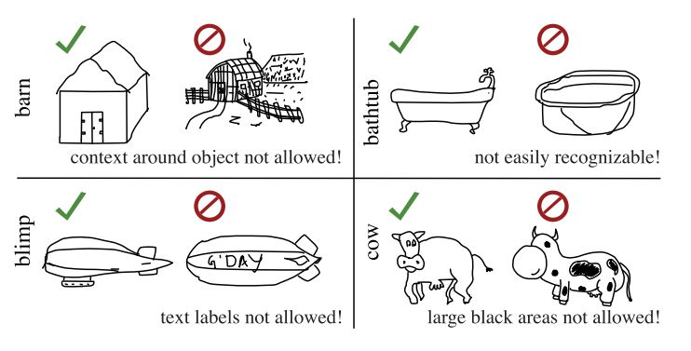
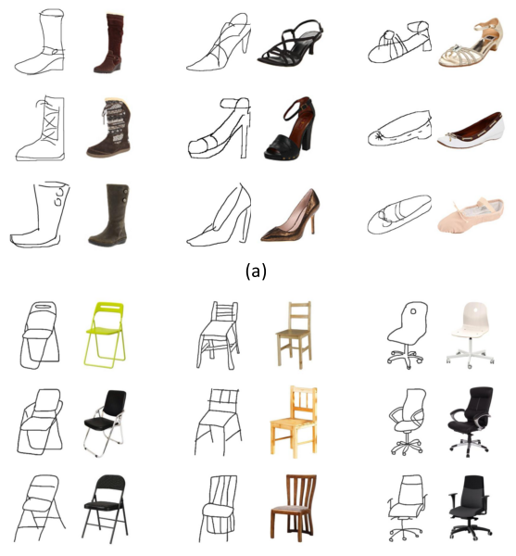
Dataset
TU-Berlin sketch dataset: a sketch dataset containing 250 categories and 80 sketches in each category.
Fine-grain sketch dataset: paired fine-grain sketch and image of shoes and chairs.
TU-Berlin sketch dataset
Fine-grain sketch dataset

Slide 14
Original idea
Sketch to Photo Translation
Problem definition
Why sketch?
Characteristic of Sketch
Related works
Sketch2Photo
Sketch-based classification
Sketch-based retrieval
Image-to-image translation
Unpaired image-to-image translation
Exploration
CycleGAN
DiscoGAN

Slide 15
Original idea
Sketch to Photo Translation
Problem definition
Why sketch?
Characteristic of Sketch
Related works
Sketch2Photo
Sketch-based classification
Sketch-based retrieval
Image-to-image translation
Unpaired image-to-image translation
Exploration
CycleGAN
DiscoGAN

Slide 16
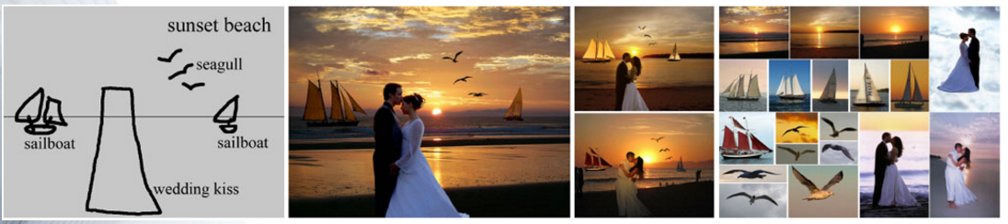
Sketch2Photo: Internet Image Montage
Generate a realistic image using a simple freehand sketch annotated with text labels.
Text labeled sketch
Seamlessly stitching several photograph

Slide 17
Sketch2Photo: Internet Image Montage
Generate a realistic image using a simple freehand sketch annotated with text labels.
Text labeled sketch
We want labeling to be done automatically (sketch classification).
Seamlessly stitching several photograph
We want to generate a totally new image that every detail be generated, rather than a regional combination of existing image parts.

Slide 18
Original idea
Sketch to Photo Translation
Problem definition
Why sketch?
Characteristic of Sketch
Related works
Sketch2Photo
Sketch-based classification
Sketch-based retrieval
Image-to-image translation
Unpaired image-to-image translation
Exploration
CycleGAN
DiscoGAN

Slide 19
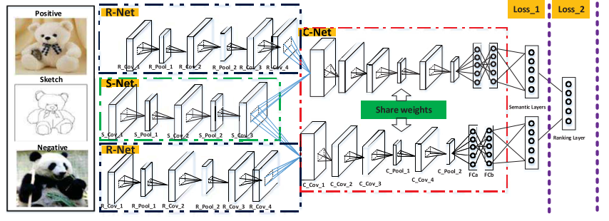
Sketch classification: SketchNet
Discover the discriminative structures of sketch images
Triplet networks based on Siamese nets
Weekly supervised: with the help of photo images
H. Zhang 2016

Slide 20
Sketch classification: Sketch-a-Net
A novel method of data augmentation
Bayesian fusion
Multiple models of different scales
Beats human in sketch classification performance
Sketch-a-Net, Q. Yu 2016

Slide 21
Sketch classification
Summary and inspirations
Deep neural networks are able to handle sketch classification.
Sketches with high intra-class variance are still able to mapped together in specific embedding space.
There should be no need to annotate the sketch with text label.

Slide 22
Original idea
Sketch to Photo Translation
Problem definition
Why sketch?
Characteristic of Sketch
Related works
Sketch2Photo
Sketch-based classification
Sketch-based retrieval
Image-to-image translation
Unpaired image-to-image translation
Exploration
CycleGAN
DiscoGAN

Slide 23
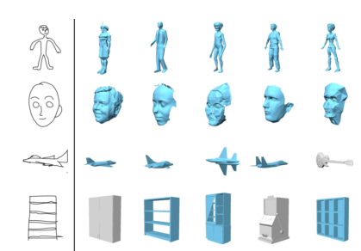
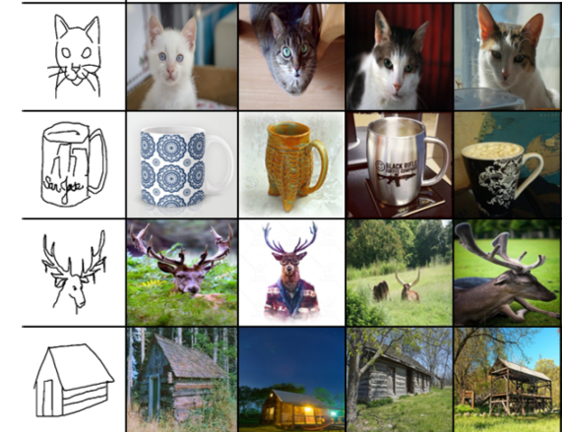
Sketch-based retrieval
Sketch-based 3D model retrieval
Sketch-based image retrieval
Sketch-based fine-grain image retrieval
3D model retrieval, F. Wang et al 2015
Image retrieval, P. Sangkloy et al 2016
Fine-grain image retrieval, Q. Yu et al 2016

Slide 24
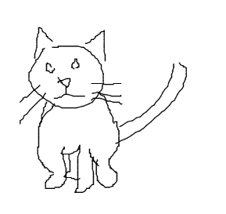
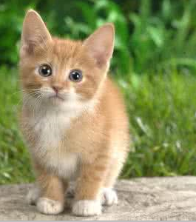
Sketch-based retrieval
Summary and inspirations
Minimize the distance between sketch and photo in embedding space
A sketch and a similar photo are able to mapped close to each other in specific embedding space.
EASY
HARD
Inspired architecture of sketch-to-photo translation

Slide 25
Original idea
Sketch to Photo Translation
Problem definition
Why sketch?
Characteristic of Sketch
Related works
Sketch2Photo
Sketch-based classification
Sketch-based retrieval
Image-to-image translation
Unpaired image-to-image translation
Exploration
CycleGAN
DiscoGAN

Slide 26
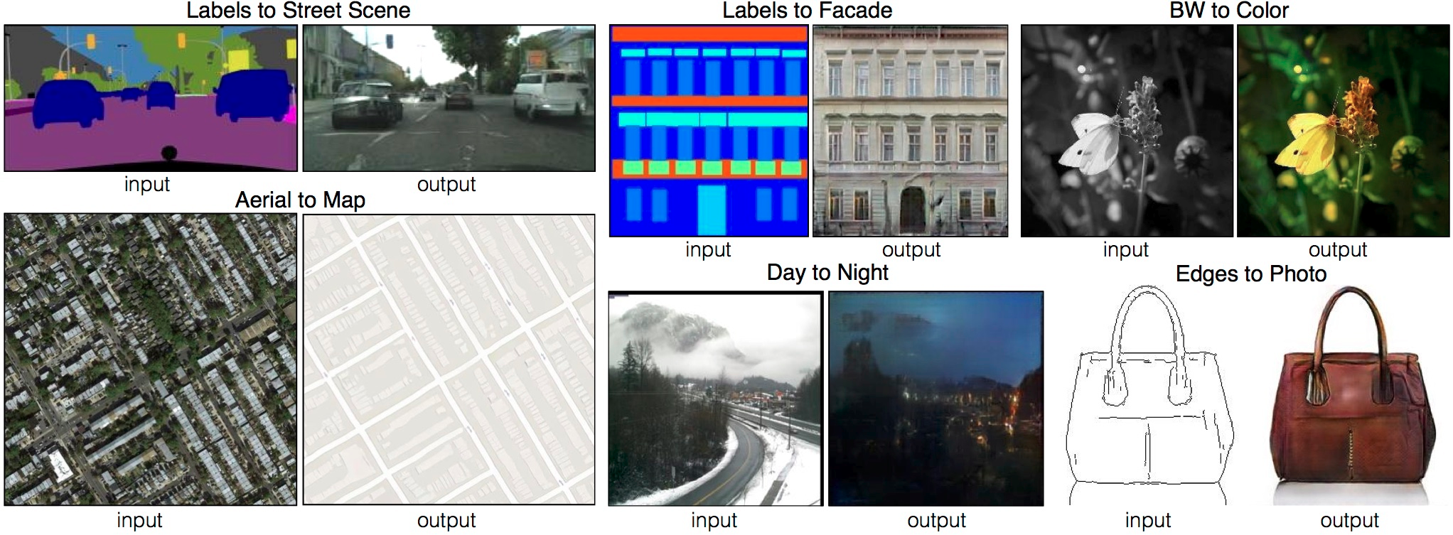
Image-to-image translation
Based on generative adversarial nets (GANs)
Paired images for training
A framework for multiple applications, only switching the training sets.
Image-to-image translation, P. Isola et al 2016

Slide 27
Image-to-image translation
Based on generative adversarial nets (GANs)
Paired images for training
A framework for multiple applications, only switching the training sets.
Image-to-image translation, P. Isola et al 2016

Slide 28
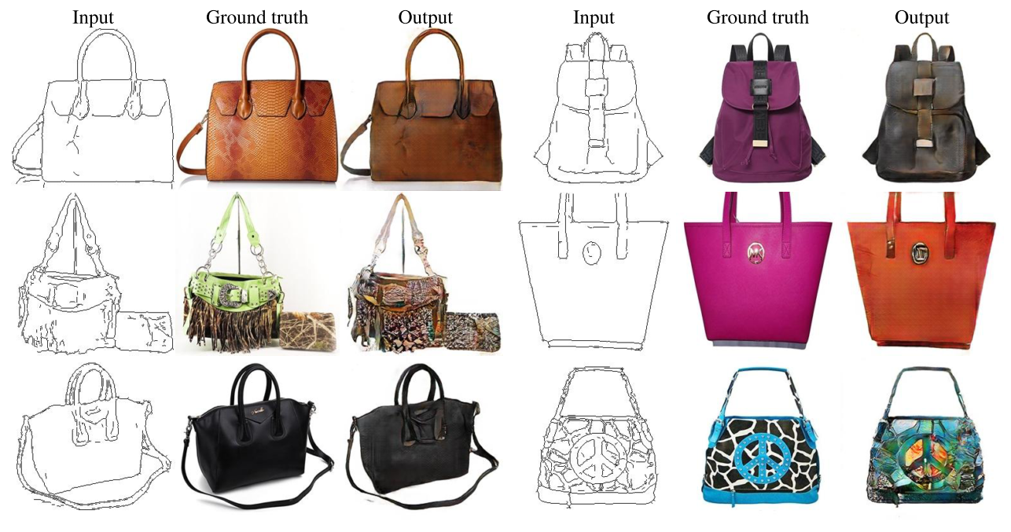
Image-to-image translation
Edge map to photo, P. Isola et al 2016

Slide 29
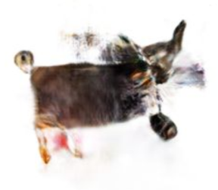
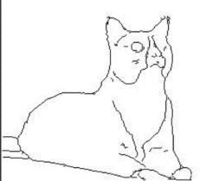
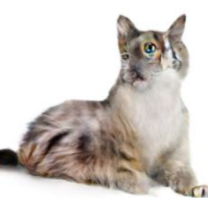
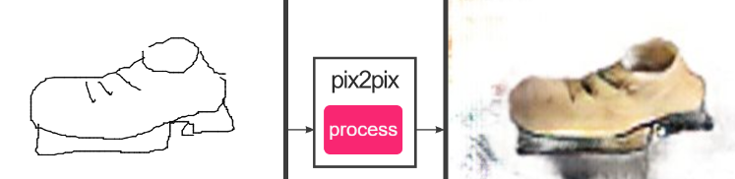
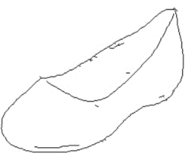
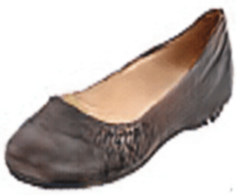
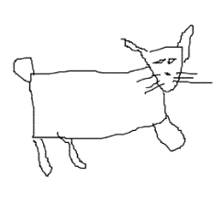
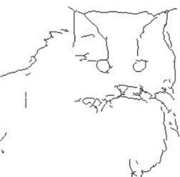
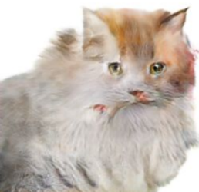
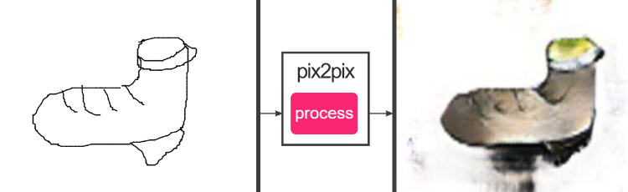
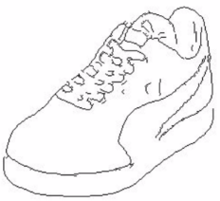
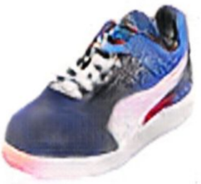
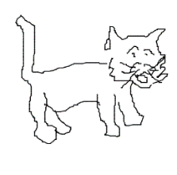
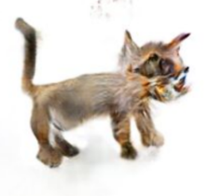
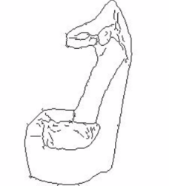
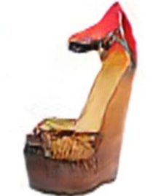
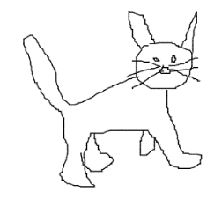
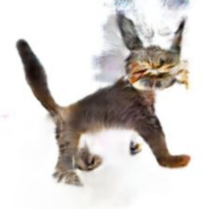
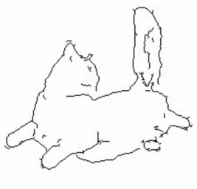
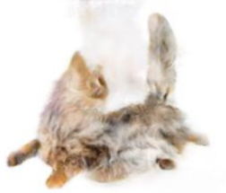
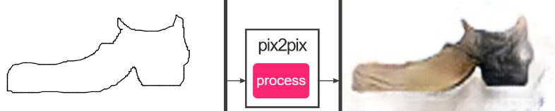
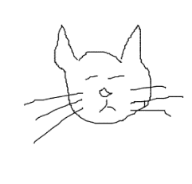
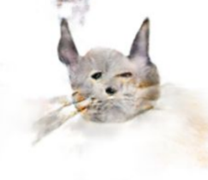

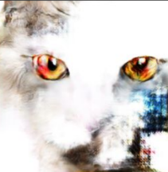
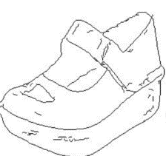
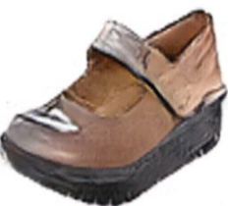
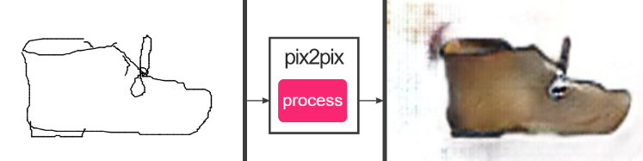
Image-to-image translation
Abstract sketch (cat) and corresponding results
Edge maps (cat) and corresponding results
Abstract sketch (shoe) and corresponding results
Edge maps (cat) and corresponding results
Results tested with a pre-trained model.

Slide 30
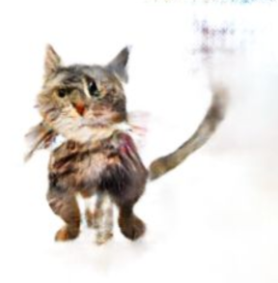
Image-to-image translation
Paired images are required
Highly complex, expensive to obtain
Sometimes, not even well–defined
Generated images are aligned to the edges. (Not only in the application of edge-to-photo)
Not able to generate good results from abstract sketches
Image-to-image translation, P. Isola et al 2016
Input abstract sketch
Output image
Expected output

Slide 31
Image-to-image translation
Summary and inspirations
GAN is a powerful framework to generate images.
Images generated by image-conditional GANs tend to remember the edge maps of the input images.

Slide 32
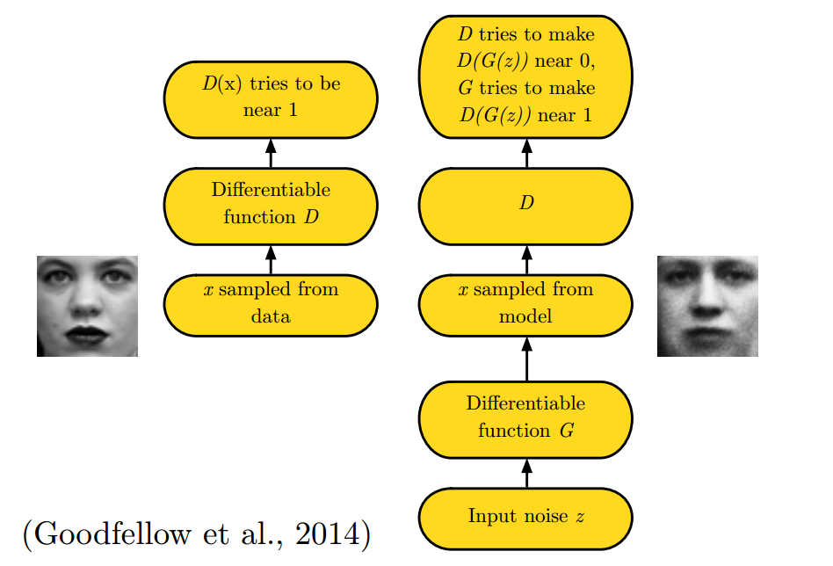
Generative Adversarial Nets (GANs)
Generate images of a given dataset by adversarial training
Discriminator
Generator
Minmax game
Problems
Unstable in training (sensitive to hyper parameters)
Mode collapse
Notes:
Discriminator
The policeman: distinguish whether an image is sampled from dataset or is generated by the generator
Generator
The thief: generate images that looks like samples of dataset to deceive the discriminator

Slide 33
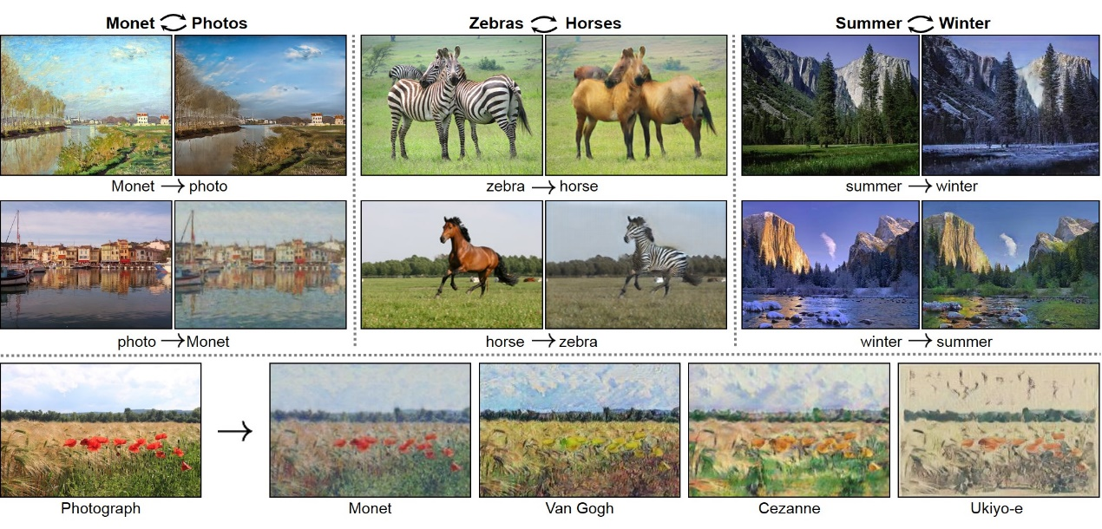

Unpaired image translation
Unpaired images datasets
Generate images from one domain to another
Cycle consistency
Reconstruct the input image from
generated image
CycleGAN, J. Zhu et al 2017

Slide 34


Unpaired image translation
Unpaired images datasets
Generate images from one domain to another
Cycle consistency (same idea)
Reconstruct the input image from
generated image
DiscoGAN, T. Kim et al 2017

Slide 35
Unpaired image translation
Summary and inspirations
Unpaired image datasets
Easy to obtain
Not necessary to be edge aligned
Preserve shared attributions
DiscoGAN, T. Kim et al 2017

Slide 36
Original idea
Sketch to Photo Translation
Problem definition
Why sketch?
Characteristic of Sketch
Related works
Sketch2Photo
Sketch-based classification
Sketch-based retrieval
Image-to-image translation
Exploration
CycleGAN
DiscoGAN

Slide 37


Exploration: CycleGAN
Architecture details
Residual blocks
Instance normalization
Generated image pool
Notes:
Residual blocks
In spired by Johnson et. al., in the bottleneck layers, residual blocks are added to transfer features of A image to features of B.
Instance normalization
Instance normalization is also unknown as contrast normalization. CycleGANs swap batch normalization with instance normalization in both training and testing time since we want to keep the content instead of style and contract is clearly not a part of content in the image.
Generated image pool
CycleGANs discard both random vector and drop which introduce stochasticity in the training procedure and use the historical generated images to update the discriminators by maintaining a generated image pool with size of 50. The pool is filled with first generated 50 images and updated by replacing one of randomly selected images in it with the newly generated image.

Slide 38

Exploration: CycleGAN
Reported results

Slide 39

Exploration: CycleGAN
Results by training after 200 epochs with the official torch implementation. Horse to zebra dataset.
Input
Output
Input
Output
1. Real_A
(real horse)
3. Rec_A
(reconstructed horse)
2. Fake_B
(generated zebra)

Slide 40

Exploration: CycleGAN
Results by training after 200 epochs with the official torch implementation. Sketch to photo (apple) dataset.
Problems
Mode collapse (sketch to photo) every input is mapped to the same result.
All white (photo to sketch)
Input
Output
Input
Output

Slide 41

Exploration: CycleGAN
Results by training after 200 epochs with the official torch implementation. Sketch to photo (airplane) dataset.
Unexpected edge-aligned
Not able to distinguish
sketches from edge maps.
Severe mode collapse.
Input
Output
Input
Output

Slide 42

Exploration: DiscoGAN
Results by training after 200 epochs with the official torch implementation. Shoe to handbag dataset.
A light mode collapse
(marked in different colors)
Not able to reconstruct
input images (3rd column)

Slide 43
























Exploration: DiscoGAN
Results by training after 200 epochs with the official torch implementation. Sketch to photo (shoe) dataset.

Slide 44
Insights and plan
Edge aligned issue
Need an additional mechanism to help the model to distinguish sketch from edge maps
Try to add negative samples (edge maps) to the training procedure
An image is composed of content and appearance.
Content is the shared information between photos and sketches; appearances vary from photos to sketches.
Content information is represented by the feature maps of neural networks; appearance information is stored in the weights of the convolution layers (J.Johnson et al 2016).
The deeper the network is, the higher level semantic information is extracted.
Try a deeper network to focus on classification (high level) instead of edge (low level).

